Slide 1
2019
SUPER MARIO
TAQ MATHS

Slide 2
01
PROBLEM STATEMENT
02
ANALYSIS
CONTENTS
03
DESIGN
04
IMPLEMENTAITON
05
TEST

Slide 3
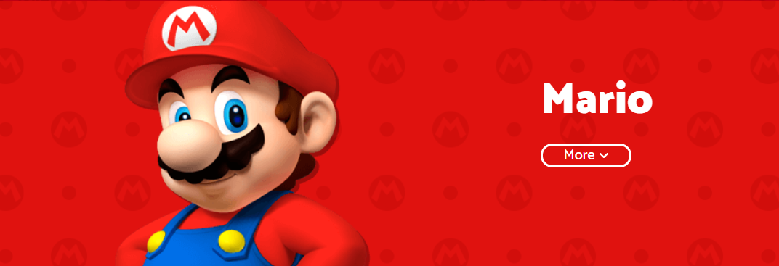
PROBLEM STATEMENT
ANALYSIS
DESIGN
IMPLEMENTAITON
TEST

Slide 4
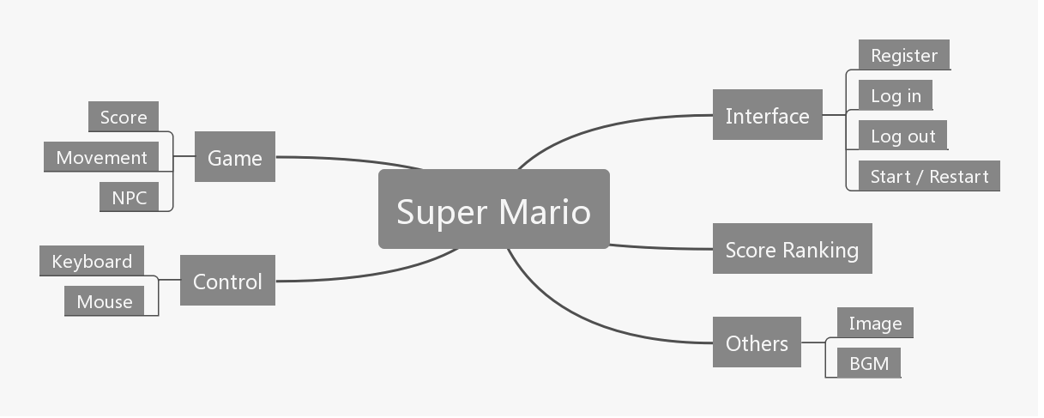
PROBLEM STATEMENT
ANALYSIS
DESIGN
IMPLEMENTAITON
TEST
25%
50%
15%
10%
INTERFACE
GAME
SCORE
CONTROL

Slide 5
PROBLEM STATEMENT
ANALYSIS
DESIGN
IMPLEMENTAITON
TEST
PROBLEMS TO BE SOLVED
FUNCTION
ROLE
SCORE
WHAT KIND OF FUNCTIONS DO WE NEED
SECTOR OUR PROJECT INTO DEFFERENT PARTS
HOW TO MAKE OUR SCORE RANK
INTERFACE
IMAGE
KEYBOARD
HOW TO DESIGN OUR INTERFACE
HOW TO MAKE OUR IMAGES TRANSPARENT
HOW TO USE KEYBOARD TO CONTROL MARIO

Slide 6
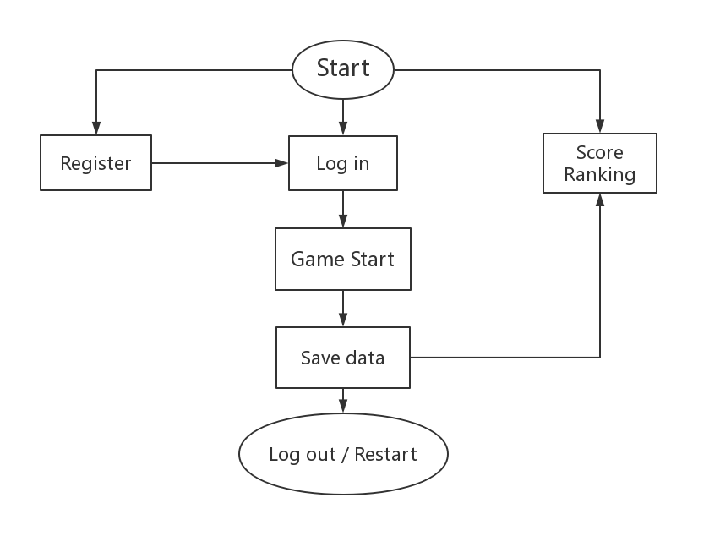
PROBLEM STATEMENT
ANALYSIS
DESIGN
IMPLEMENTAITON
TEST
START A GAME

Slide 7
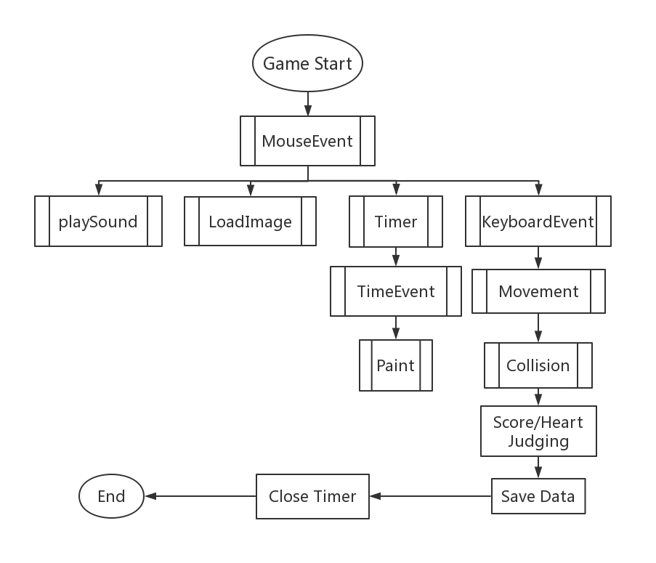
PROBLEM STATEMENT
ANALYSIS
DESIGN
IMPLEMENTAITON
TEST
HOW TO DESIGN

Slide 8
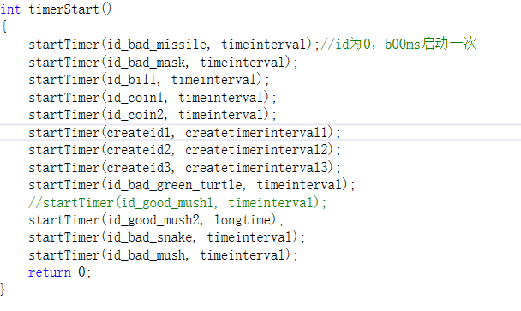
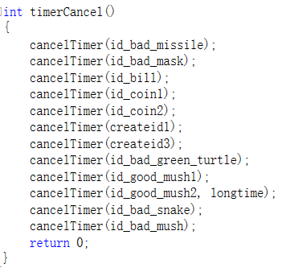
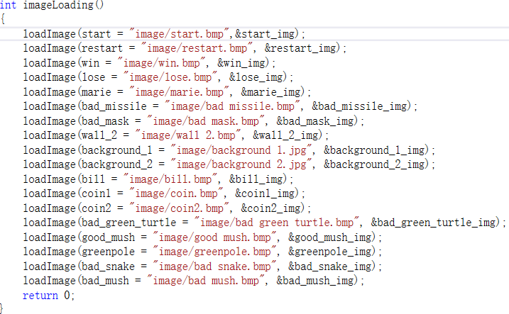
PROBLEM STATEMENT
ANALYSIS
DESIGN
IMPLEMENTAITON
TEST

Slide 9
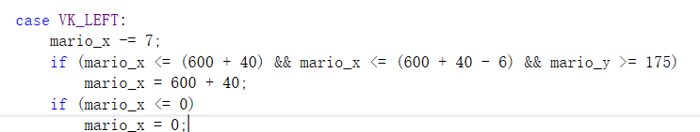
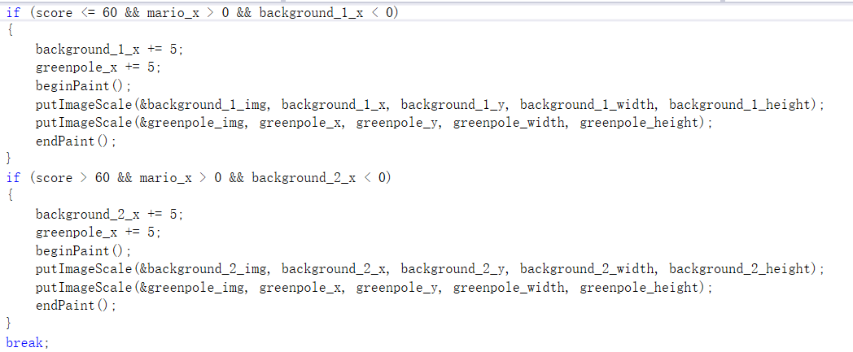
PROBLEM STATEMENT
ANALYSIS
DESIGN
IMPLEMENTAITON
TEST

Slide 10
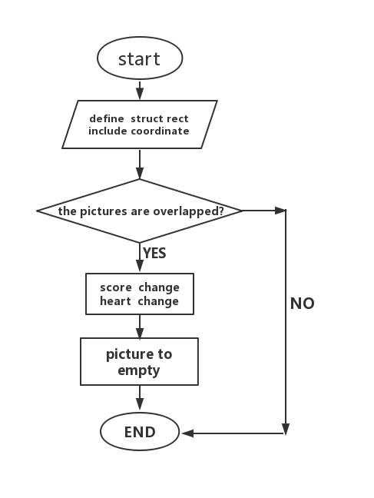
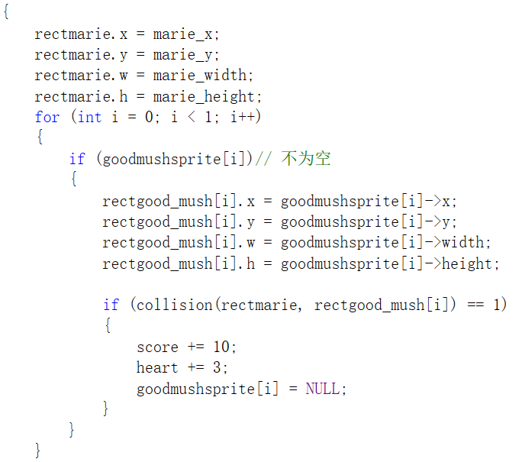
PROBLEM STATEMENT
ANALYSIS
DESIGN
IMPLEMENTAITON
TEST

Slide 11
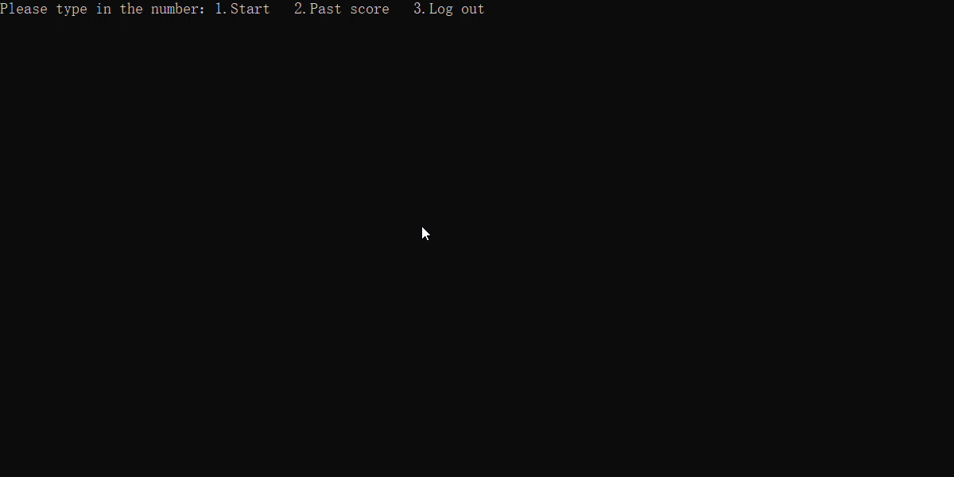
PROBLEM STATEMENT
ANALYSIS
DESIGN
IMPLEMENTAITON
TEST

Slide 12
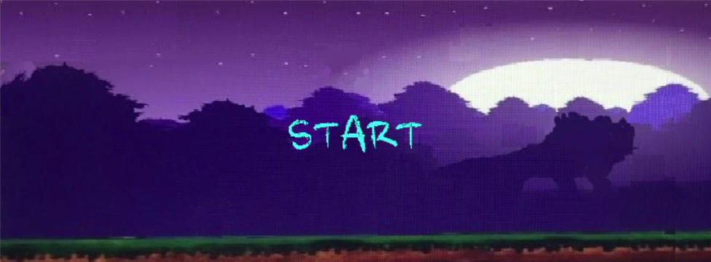
PROBLEM STATEMENT
ANALYSIS
DESIGN
IMPLEMENTAITON
TEST

Slide 13
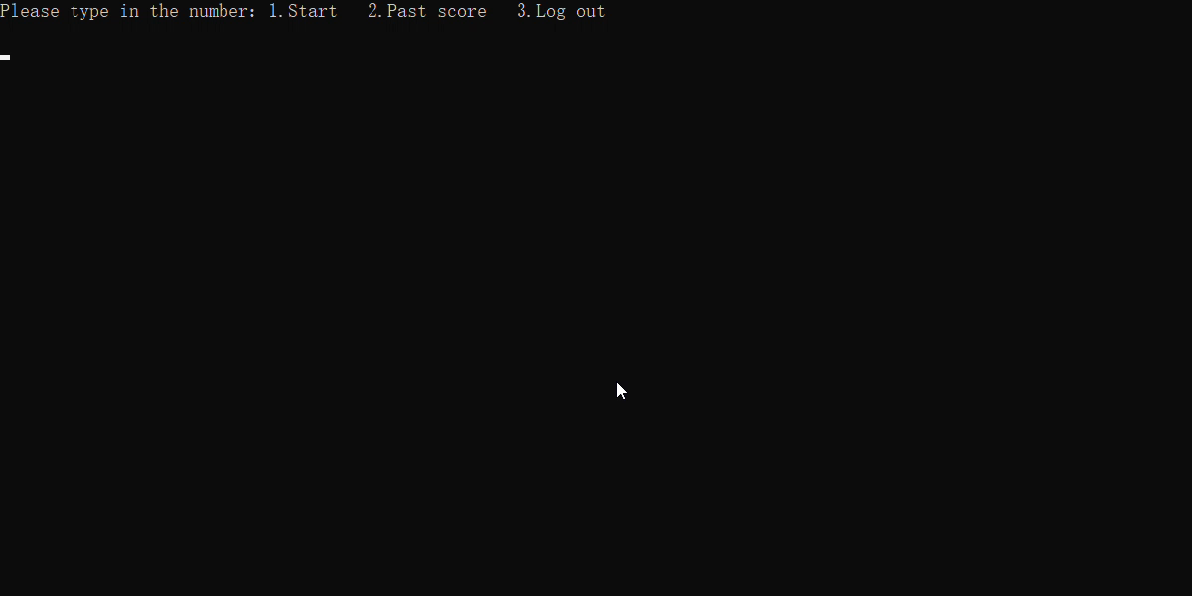
PROBLEM STATEMENT
ANALYSIS
DESIGN
IMPLEMENTAITON
TEST

Slide 14
REFLECTION
LESSION 1
01
LESSION 2
HOW TO FIND ONLINE RESOURCES TO LEARN ANYTHING WE DO NOT UNDERSTAND
02
HOW TO COLLABORATE IN A GROUP TO SECTOR OUR PROKECT INTO DIFFERENT PARTS
LESSION 3
03
LESSION 4
HOW TO SOLVE A PROBLEM EFFICIENTLY BY ASKING DEBUG OR SEARCHING FOR HELP ONLINE
04
HOW TO IMPROVE OUR C PROGRAMMING GAME BY LISTENING TO OTHERS’SUGGESTIONS

Slide 15
2019
THANKS FOR WATCHING

